Slide 1
Imagine every member of our church actively participating in missions.
Engage Our Whole Church in Global Ministry

Slide 2
Switchboard makes this possible.
It’s a virtual platform connecting believers to needs on mission teams worldwide …
and it’s simple, secure and effective.
Engage Our Whole Church in Global Ministry

Slide 3
Engage Our Whole Church in Global Ministry

Slide 4
Church members want to be involved in missions, but some:
Engage Our Whole Church in Global Ministry
feel unqualified
don’t know where to start
have time constraints

Slide 5
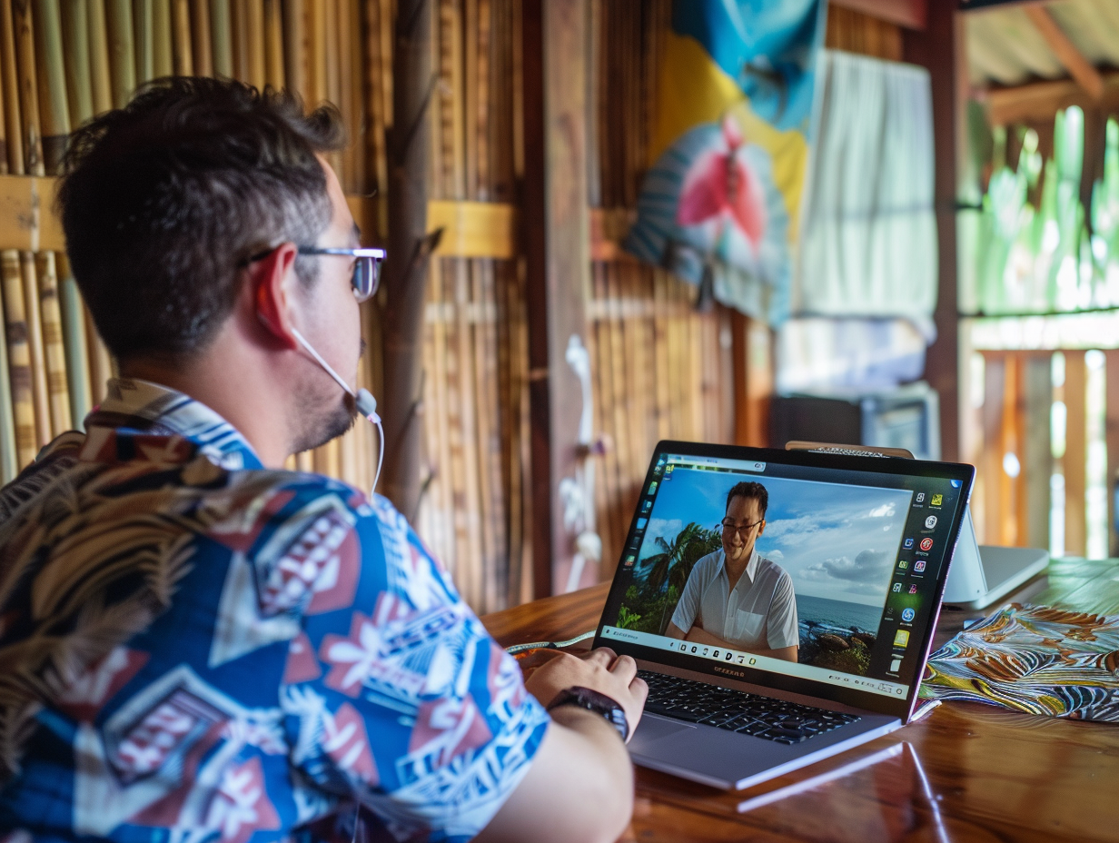
Switchboard removes these barriers by:
Engage Our Whole Church in Global Ministry
Uncovering hidden talents and passions within the congregation
Increasing member engagement
More effectively supporting missionaries

Slide 6
How it works:
Engage Our Whole Church in Global Ministry
Members create a profile
Switchboard matches them with missionaries’ needs
Members and missionaries meet virtually

Slide 7
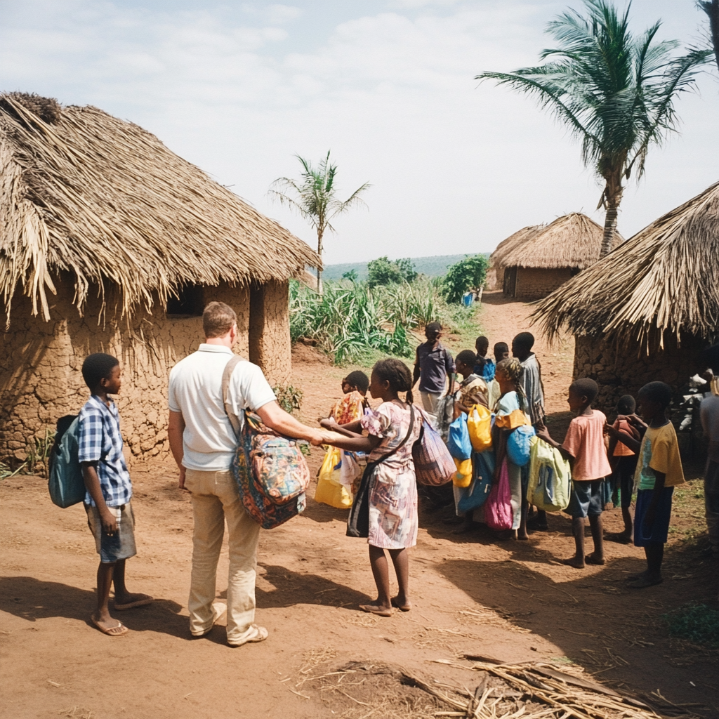
Our Missionaries:
Engage Our Whole Church in Global Ministry
Post needs
Are matched with skilled believers
Receive support that allows them to focus on their core ministry work.

Slide 8
Virtual missions makes a difference.
“Switchboard allowed me to use my marketing skills to help someone very specifically who had a specific need and then see that impact.”
Joel,
Kingdom Consultant
“Switchboard volunteers reduced stress on our team, letting us focus on God’s work.”
Peter,
Missionary
“This tool changes how we can think about mobilizing people towards the Great Commission.”
Keaton, Missions Pastor
Engage Our Whole Church in Global Ministry

Slide 9
Next Steps:
Engage Our Whole Church in Global Ministry
Approve Switchboard
Announce the program
Empower a point person to engage the whole church

Slide 10
By supporting this initiative, you can mobilize every member of our church to find their part in God’s global story.
Engage Our Whole Church in Global Ministry

