Slide 1
Find Your Role in God’s Global Story
Find Your Role in God’s Global Story
Notes:
Again, I don’t think the gray bar belongs on the first slide … it’s just a stutter quote and distracting. Also distracting are the six-fingered hands.

Slide 2
Imagine if every member of our church played a part in the Great Commission.
Switchboard connects us to global missions through our unique skills.
Find Your Role in God’s Global Story

Slide 3
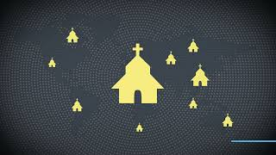
Find Your Role in God’s Global Story

Slide 4
You want to participate, but you may feel:
Find Your Role in God’s Global Story
Unqualified
Unsure of where to start
Limited by time or resources

Slide 5
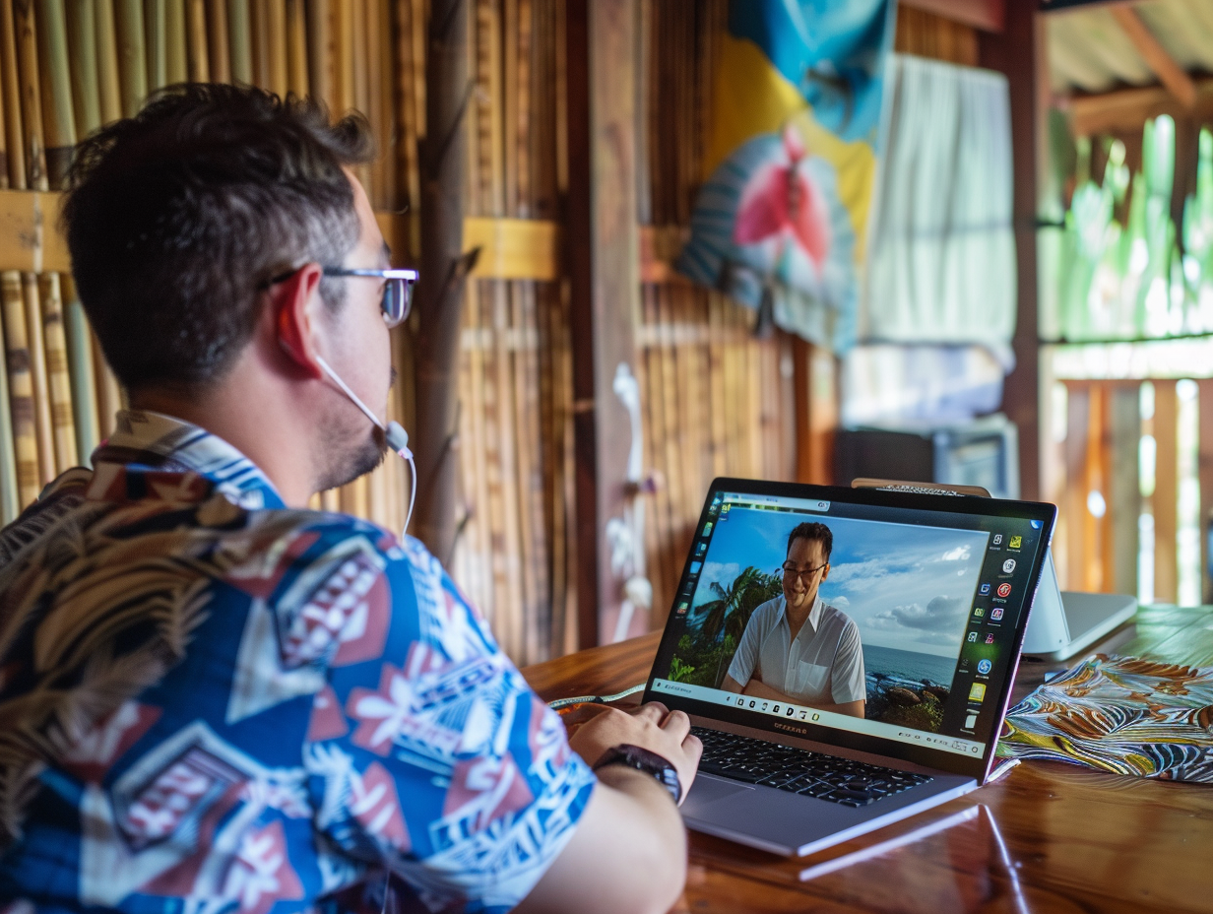
Switchboard removes these barriers by:
Find Your Role in God’s Global Story
Uncovering hidden talents and passions
Providing opportunities from around the world
Connecting you with missionaries who need your help

Slide 6
Discover how God has uniquely equipped you to serve.
Find Your Role in God’s Global Story
Take the Switchboard Skill Assessment to uncover your strengths and passions.
Notes:
Note the mis-matched blue boxes at the bottom and top – right under the ‘d’ of God’s on the bottom.

Slide 7
How it Works:
Find Your Role in God’s Global Story
Step 1: Complete the skills assessment.
Step 2: Create your profile.
Step 3: Be matched with mission needs.

Slide 8
Virtual missions makes a difference.
“Switchboard allowed me to use my marketing skills to help someone very specifically who had a specific need and then see that impact.”
Joel, Kingdom Consultant
“Switchboard volunteers reduced stress on our team, letting us focus on God’s work.”
Peter, Missionary
Find Your Role in God’s Global Story

Slide 9
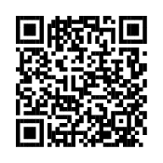
Discover your role.
Join us in transforming lives and advancing God’s Kingdom.
Find Your Role in God’s Global Story
Get started today.
globalswitchboard.io/skill-assessment

