Slide 1
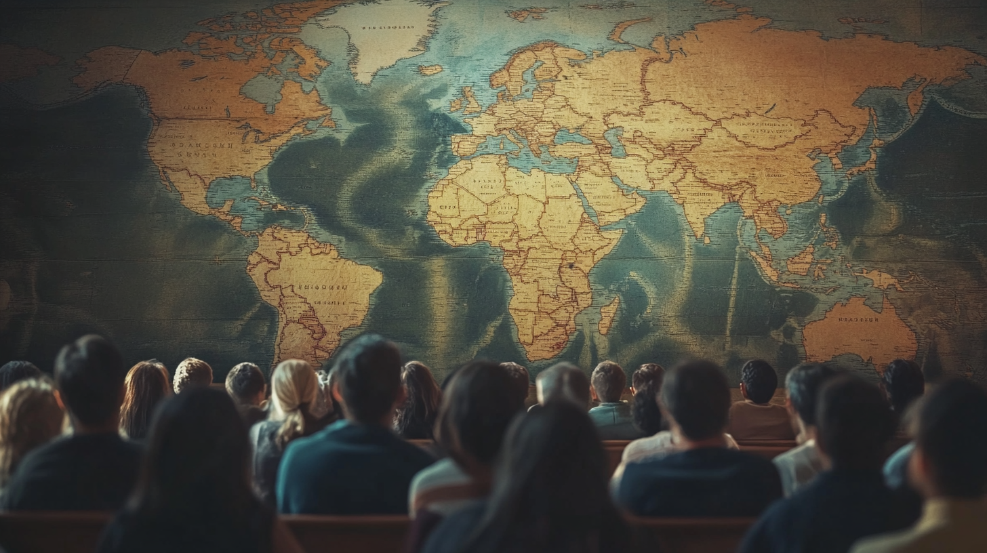
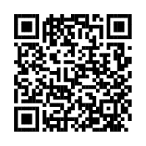
Imagine Every Member of Our Church Engaging in Global Missions
Discover how you can participate in fulfilling the Great Commission.

Slide 2
“Each of you should use whatever gift you have received to serve others, as faithful stewards of God’s grace in its various forms.”
1 Peter 4:10 (NIV)
Sign up with Switchboard to serve mission teams around the world with your unique skills.

Slide 3
Discover Your Unique Role in God’s Mission
Take the free Switchboard Skill Assessment to uncover your:
God-given talents
Passions and interests
Best-fit opportunities in global missions

Slide 4
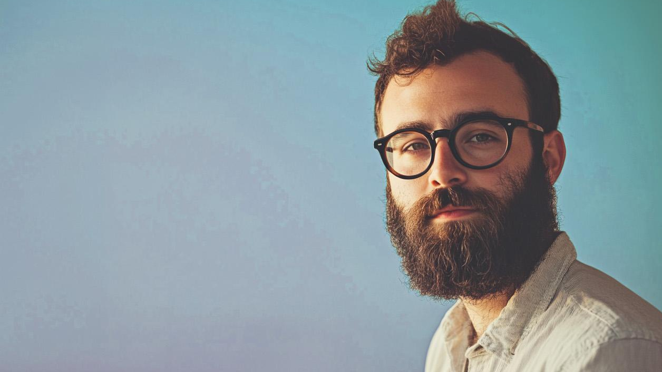
“Switchboard allowed me to use my marketing skills to help someone very specifically who had a specific need and then see that impact.”
Joel, a Switchboard volunteer in Austin, Texas
Learn more at globalswitchboard.io

Slide 5
Join Us in Advancing God’s Kingdom
Every believer has a part to play in the Great Commission. Use your skills to make a difference in global missions today.
Complete the Switchboard Skill Assessment and sign up now!

Slide 6
You don’t have to go to advance
the Kingdom!
Every believer has a part to play in the Great Commission. Use your skills to make a difference in global missions today.
Complete the Switchboard Skill Assessment and sign up now!

